Slide 1
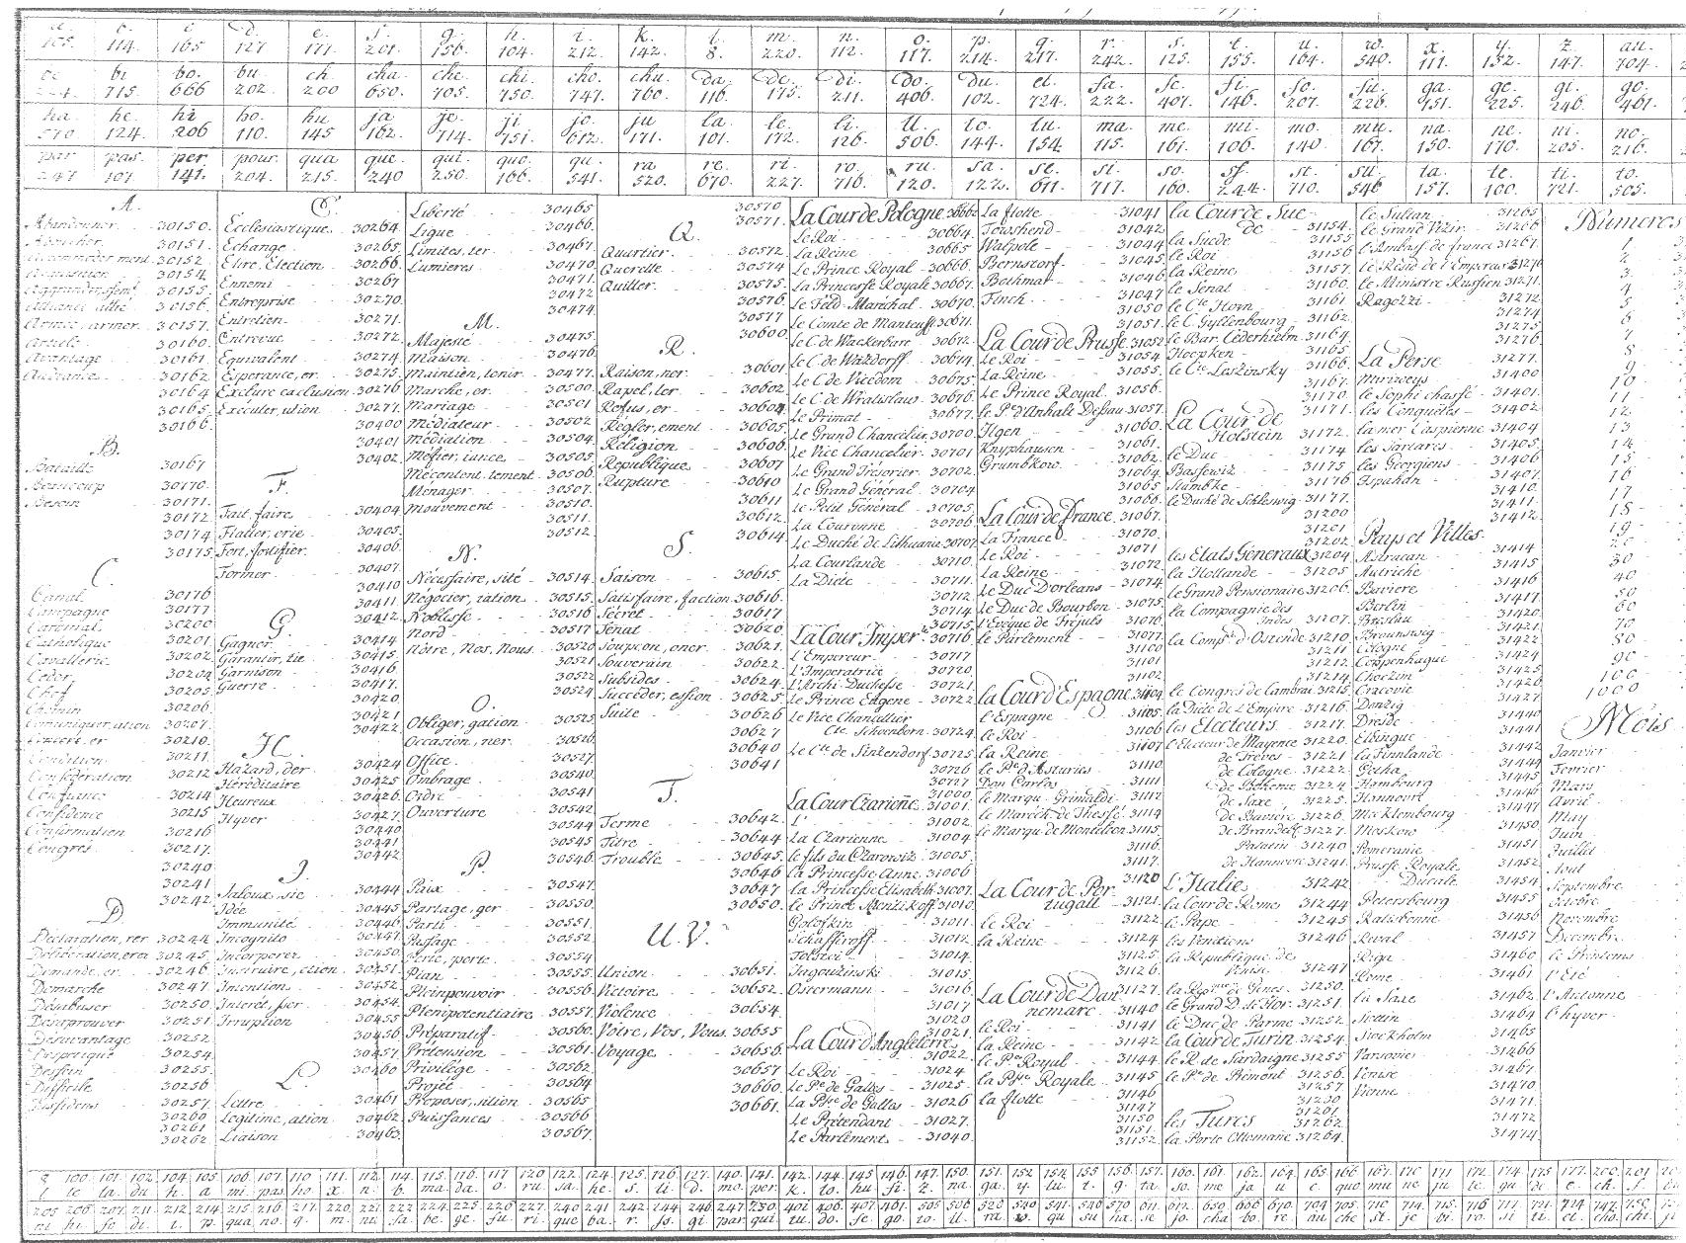
From patches in access to matches of sources
About the conversion
of a database of early modern ciphers
into an Online portal for encoded sources
Dr. habil. Anne-Simone Rous (Dresden)
Saxon Academy of Sciences and Humanities
asrous@gmail.com

Slide 2
Why a database?
many unusable encoded sources, e.g. letters
key is not near by
Repository of the key is unknown
sender and recipient are not always known
nomenclator based ciphers are very complex
one cipher may have many encoded sources
→ Solution assumption: Every cipher is unique by its metadatas.

Slide 3
Identifiers of the cipher
metadatas
(Location) 0…1…5
(date/period of (re-)use) 0…1…5
(names of the participants) 0…2…15
Language 1
structure
ciphering system
elements with no meaning (Nonvaleurs): max. 10
elements which code the alphabet and its Homophons: 26-36 * 5 = 130-180
elements with special meaning (Nomenclator): 5…20,000
in summa 150…20,216

Slide 4
12 marker for the data acquisition
place, date, names (if known) 3
Elements of nonvaleurs 2
Elements of vocals (or of most used alphabetic characters, if place/date/names are unknown) 5
Elements for „and“ and „I“ 2
12
Constantly addition by other researchers

Slide 5
„Mission impossible“?
Problems:
many special characters
missing metadata
abbreviated names
family name: which member?
partly unreadable sources

Slide 6
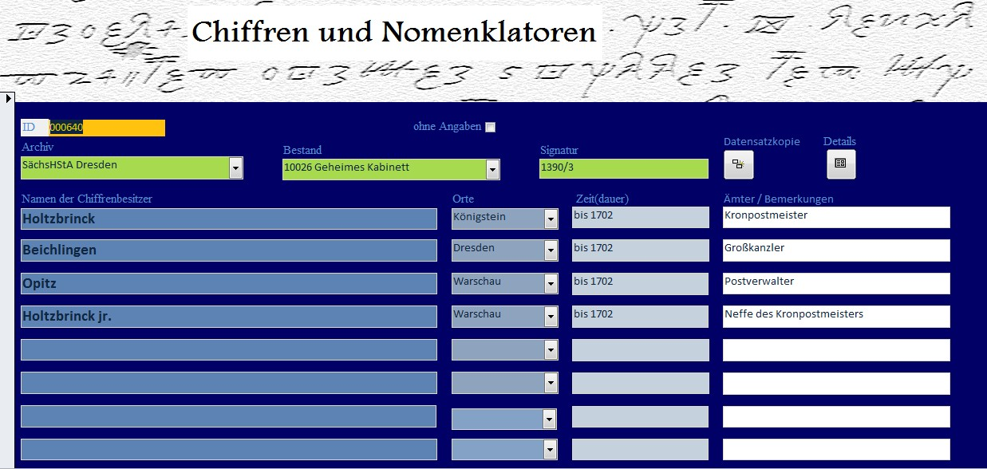
Data acquisition

Slide 8
Description of the Website
two parts: ciphers and encoded sources
names and places with normdata (GND/VIAF)
Digital copy / scan of the cipher
search function for metadatas
Export one dataset
ciphers:
mask for metadatas, signature datas, ciphersystem, elements (in selection)
Links to associated encoded sources (if known)
encoded sources:
mask for metadatas, signature datas,
Links to associated cipher (if known)
Feedback and announcement of new findings

Slide 10
Questions and Prospects
How can I transfer my database in an Online tool?
Dreams for the future:
whole cipher in the database → user can enter one encoded line and algorithm finds right cipher)
Transcription of encoded sources/Online-Edition of bundles of sources (with translation)
Expansion: subsequence ciphers of 20th century

