Slide 1
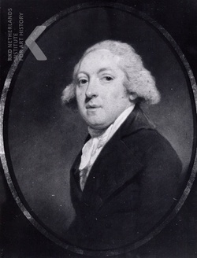
The codes of Willem Six van Oterleek
Karl de Leeuw June, 2018

Slide 2
The codes of Willem Six van Oterleek
28 Drafts in Code
from the Archives of the Dutch legation in Russia,
1808 - 1810
Karl de Leeuw June, 2018

Slide 3
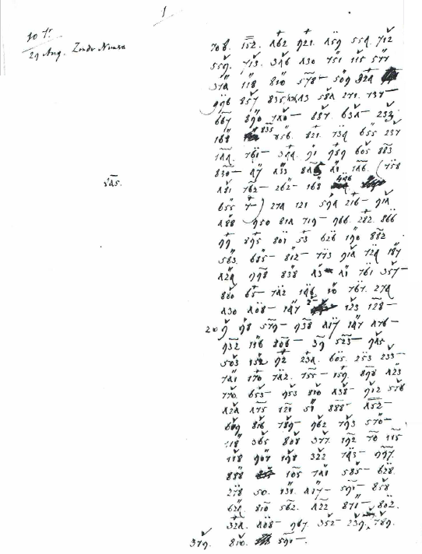
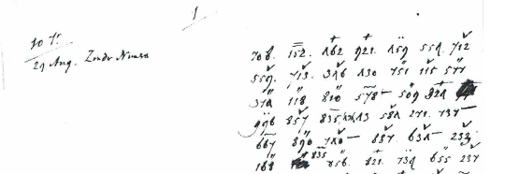
The codes of Willem Six van Oterleek
Example of a draft
Karl de Leeuw June, 2018

Slide 4
The codes of Willem Six van Oterleek
What do we know so far?
probable author: Willem Six van Oterleek (1761-1811):
Dutch emissary in Russia from 1808-1810
(b) likely to contain gossip from the Imperial court and/or intelligence
about the movement of ships and troops.
(c) we have roughly 5300 code groups in sum total
Karl de Leeuw June, 2018

Slide 5
The codes of Willem Six van Oterleek
What do we not know?
(a) were these letters ever solved?
(b) if so, do these solutions still exist and where to look for them?
(c) which codebook was being used?
(d) why were these drafts made in the first place?
Karl de Leeuw June, 2018

Slide 6
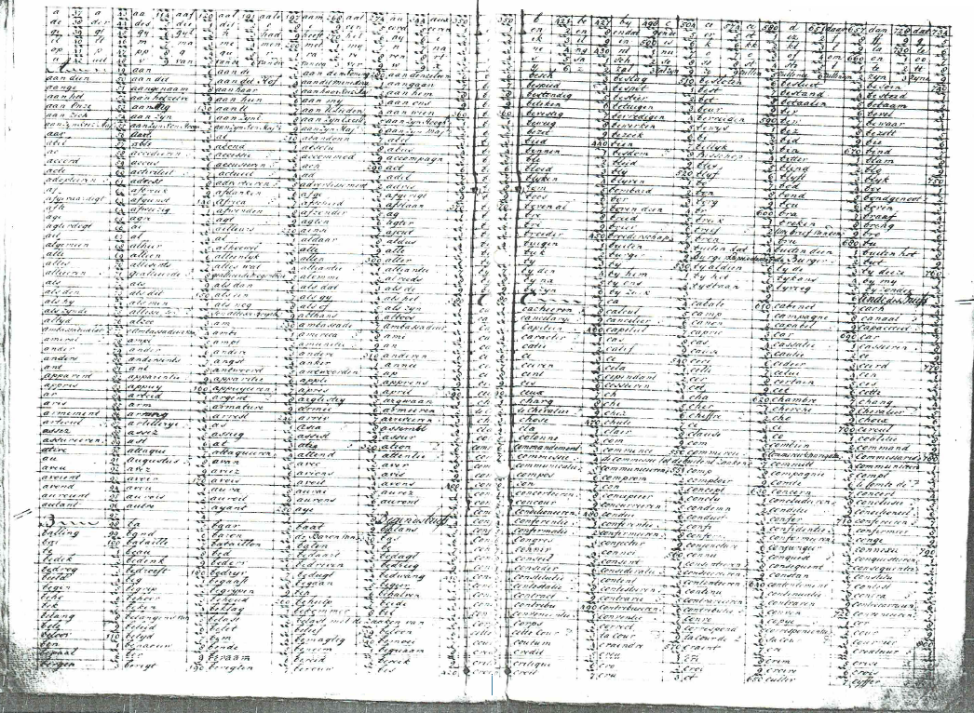
The codes of Willem Six van Oterleek
Full view of
two pages
next to
each other
Sheet of a codebook, issued by
S.E. Croiset for Dirk van Hogendorp
in August 1803 for his mission
to Saint Petersburg
Karl de Leeuw June, 2018

Slide 7
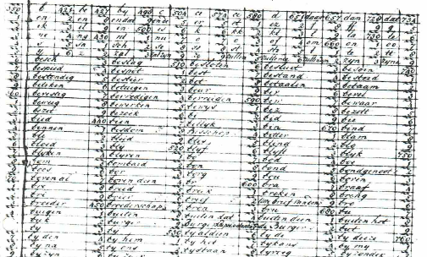
The codes of Willem Six van Oterleek
Detail
Karl de Leeuw June, 2018

Slide 8
The codes of Willem Six van Oterleek
The codebook above is a likely candidate, but we are not sure.
Main characteristics:
(1) roughly 6400 code groups divided over 16 pages
(2) 1-, 2-, or 3-digit numbers, in combination with a sign written above or under
(3) the numbers following columns; their meanings following rows
(4) every double page has a alphabet of its own, with additional groups
for frequently occurring doubling of letters or syllables
(5) can be used both for French and for Dutch
Karl de Leeuw June, 2018

Slide 9
The codes of Willem Six van Oterleek
Solving strategies:
trial and error
?
are there any general rules ,making computation worthwhile?
Karl de Leeuw June, 2018

Slide 10
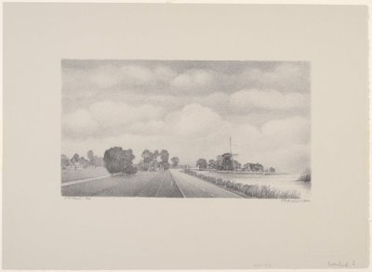
The codes of Willem Six van Oterleek
Oterleek, North Holland
Karl de Leeuw June, 2018

